Slide 1
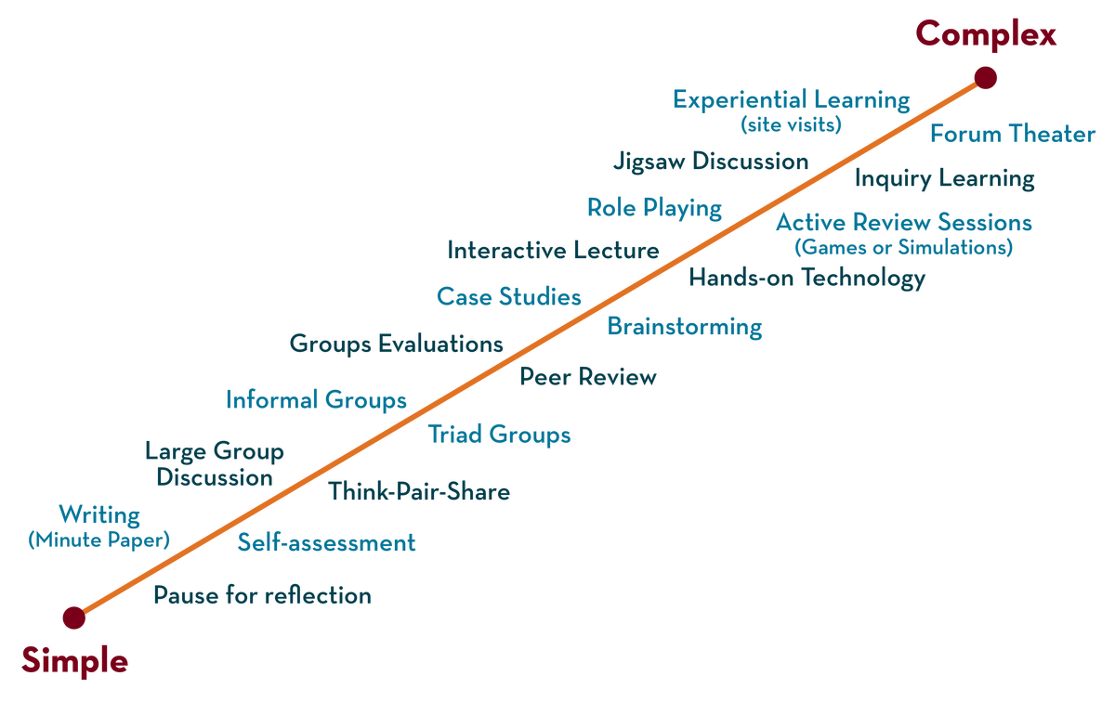

Department of CSE
Cloud & devops (EPAM)
21cs3019aa
Topic:
NETWORK FUNDAMENTALS
Session - 1

Slide 2



AIM OF THE SESSION
To familiarize students with the basic concept of networks
INSTRUCTIONAL OBJECTIVES
This Session is designed to:
Demonstrate
Describe
List out the
Describe the
LEARNING OUTCOMES
At the end of this session, you should be able to:
Describe
Summarize

Slide 3
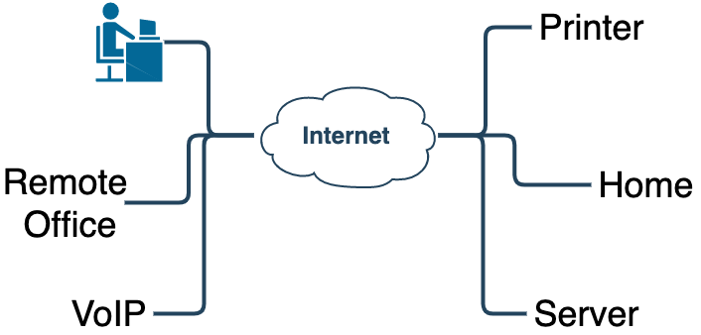
What is Network and Internet
The internet is network of networks is the large computer network in the world that connects billions of computer users.
Network is a collection of computers and devices connected via communication channels and transmission media allow to share resources (H/W, S/W, data, information)
The vast collection of computers networks which form and act as a single huge network for transport of data and messages across distances which can be anywhere from the same office to anywhere in the world

Slide 4
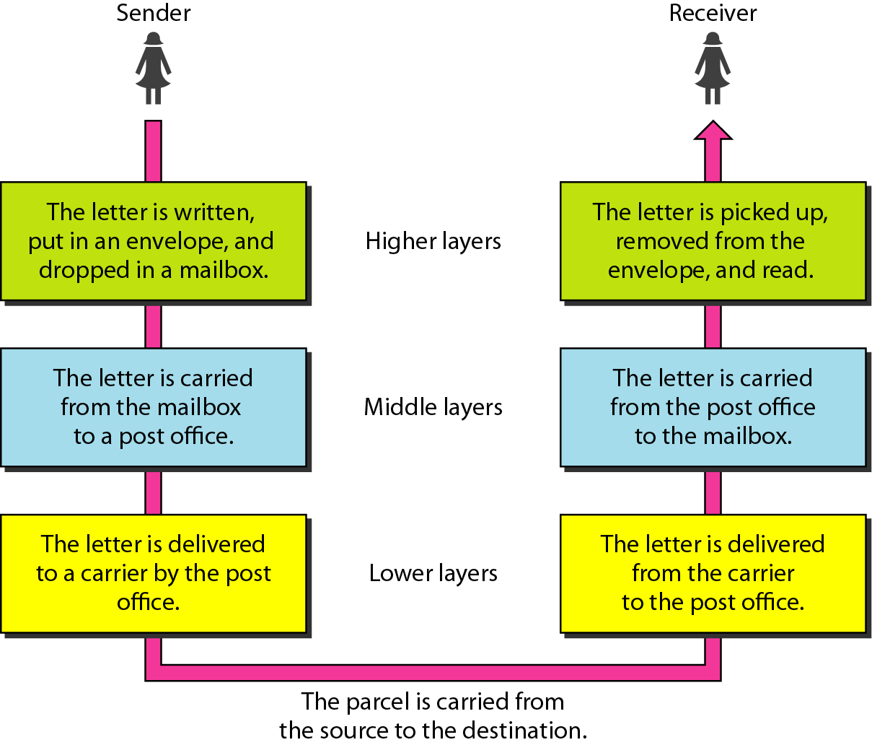

Slide 5
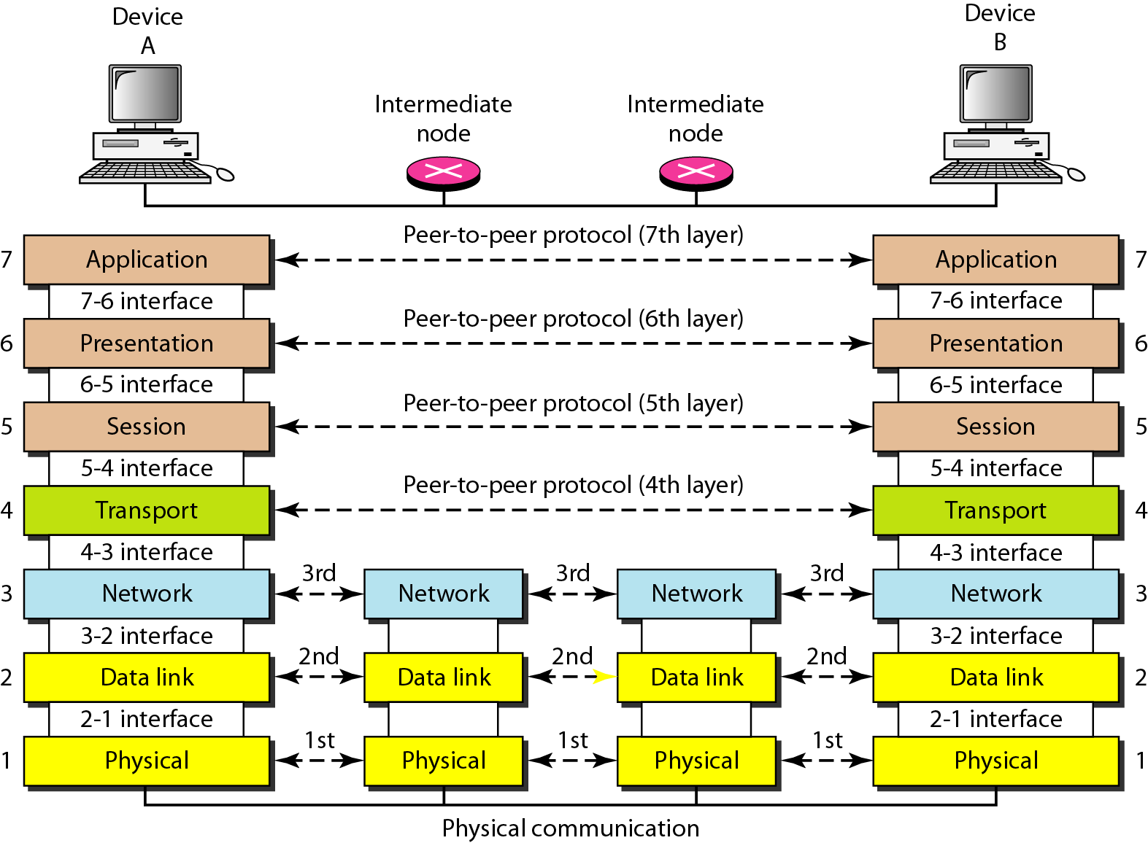

OSI Reference Model

Slide 6
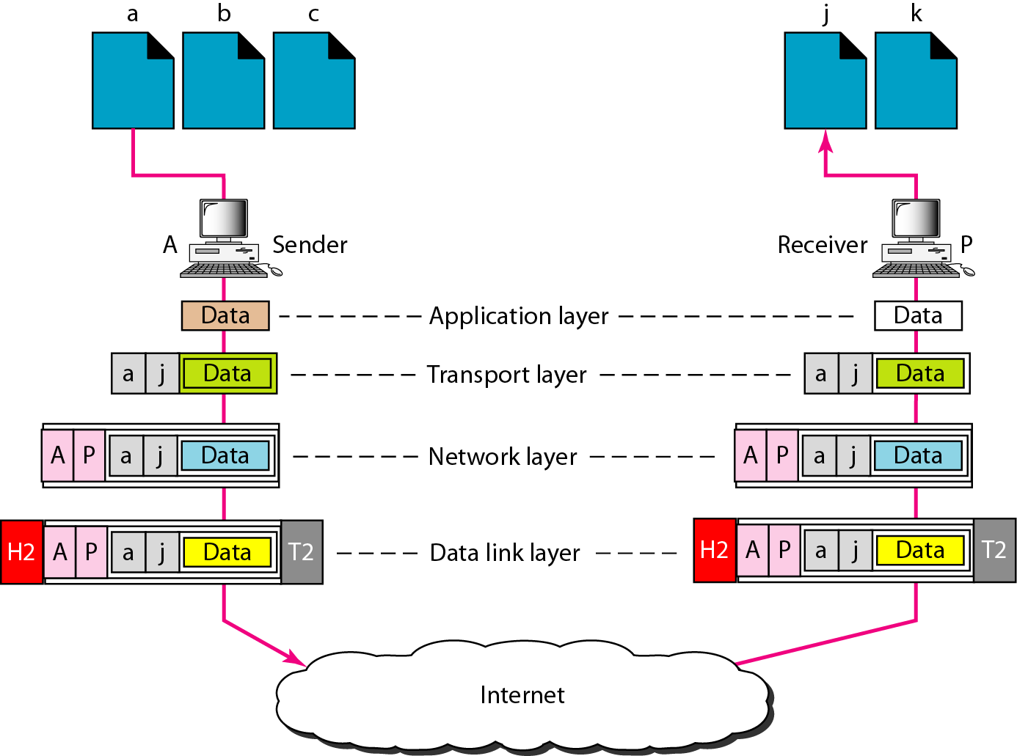
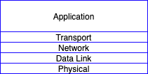
TCP/IP Model

Slide 7
The Internet needs addresses
Addresses allow endpoints to identify, and hence talk to each other
E.g., like people have names
Addresses allow routers to determine how to move a packet
E.g., like the postal system
Network layer addresses are designed to help routers perform the forwarding and routing functions efficiently
Specifically, we’ll look at Internet Protocol (IP) addresses.
Most popular: IP version 4 or IPv4. (Coming up later: IPv6)

Slide 8
IPv4 Addresses
32 bits long
Identifier for a network interface
An IP address corresponds to the point of attachment of an endpoint to the network.
An IP address is NOT an identifier for the endpoint
Dotted quad notation: each byte is written in decimal in MSB order, separated by dots. Example:
10000000 11000011 00000001 01010000
128 . 95 . 1 . 80

Slide 9
Grouping IP addresses by prefixes
IP addresses can be grouped based on a shared prefix of a specified length
Example: consider two IP addresses:
128.95.1.80 and 128.95.1.4
The addresses share a prefix of (bit) length 24: 128.95.1
The addresses have different suffixes of (bit) length 8
IP addresses: prefix corresponds to the network component and the suffix to an endpoint/host component of the address

Slide 10
Classful IPv4 addressing

Slide 11
Classful IPv4 addressing
Class
32 bits
0.x.x.x – 127.x.x.x
Unicast: single endpoint dest
A
0
Net
Host
B
10
Net
Host
128.x.x.x – 191.x.x.x
Unicast: single endpoint dest
192.x.x.x – 223.x.x.x
Unicast: single endpoint dest
224.x.x.x – 239.x.x.x
Destination is a group of hosts
240.x.x.x – 255.x.x.x
First octet of IP address gives you the prefix length.
C
110
Net
Host
D
1110
Multicast address
E
1111
Reserved
8 bit prefix
16 bit prefix
24 bit prefix

Slide 12
Classful IPv4 addressing
Class A:
For very large organizations
2²⁴ = 16 million hosts allowed
Class B:
For large organizations
2¹⁶ = 65 thousand hosts allowed
Class C
For small organizations
2⁸ = 255 hosts allowed
Class D
Multicast addresses
No network/host hierarchy

Slide 13
Classless IPv4 addressing (CIDR)- Classless Inter Domain Routing

Slide 14
Classless IPv4 addressing
Also called classless inter-domain routing (CIDR)
Key idea: Network component of the address (ie: prefix) can have any length (usually from 8—32)
Address format: a.b.c.d/x, where x is the prefix length
Customary to use 0s for all suffix bits
network part
host part
11001000 00010111 00010000 00000000
200.23.16.0/23

Slide 15
CIDR
An ISP can obtain a block of addresses and partition this further to its customers
Say an ISP has 200.8.0.0/16 address (65K addresses).
The ISP has customer who needs only 64 addresses starting from 200.8.4.128
Then that block can be specified as 200.8.4.128/26
200.8.4.128/26 is “inside” 200.8.0.0/16
200.8.0.0/16
200.8.0.0
200.8.0.1
… 200.8.1.0
200.8.1.1
…
200.8.4.128/26
200.8.255.255

Slide 16
Netmask (or subnet mask)
An alternative to denote the IP prefix length of an organization
32 bits: a 1-bit denotes a prefix bit position. 0 is the host part.
network part
host part
11001000 00010111 00010000 00000000
200.23.16.0/23
network part _{Host part} of mask _{of mask}
11111111 11111111 11111110 00000000
Netmask: 255.255.254.0

Slide 17
Protocols/Ports
A set of rules or guidelines.
Communications protocol is a formal description of message formats and the rules for exchanging those messages
Format that agreed to transfer data between two devices:
HTTP/HTTPS
IP
FTP
SMTP
TCP and UDP
DNS
DHCP
ARP,RARP

Slide 18
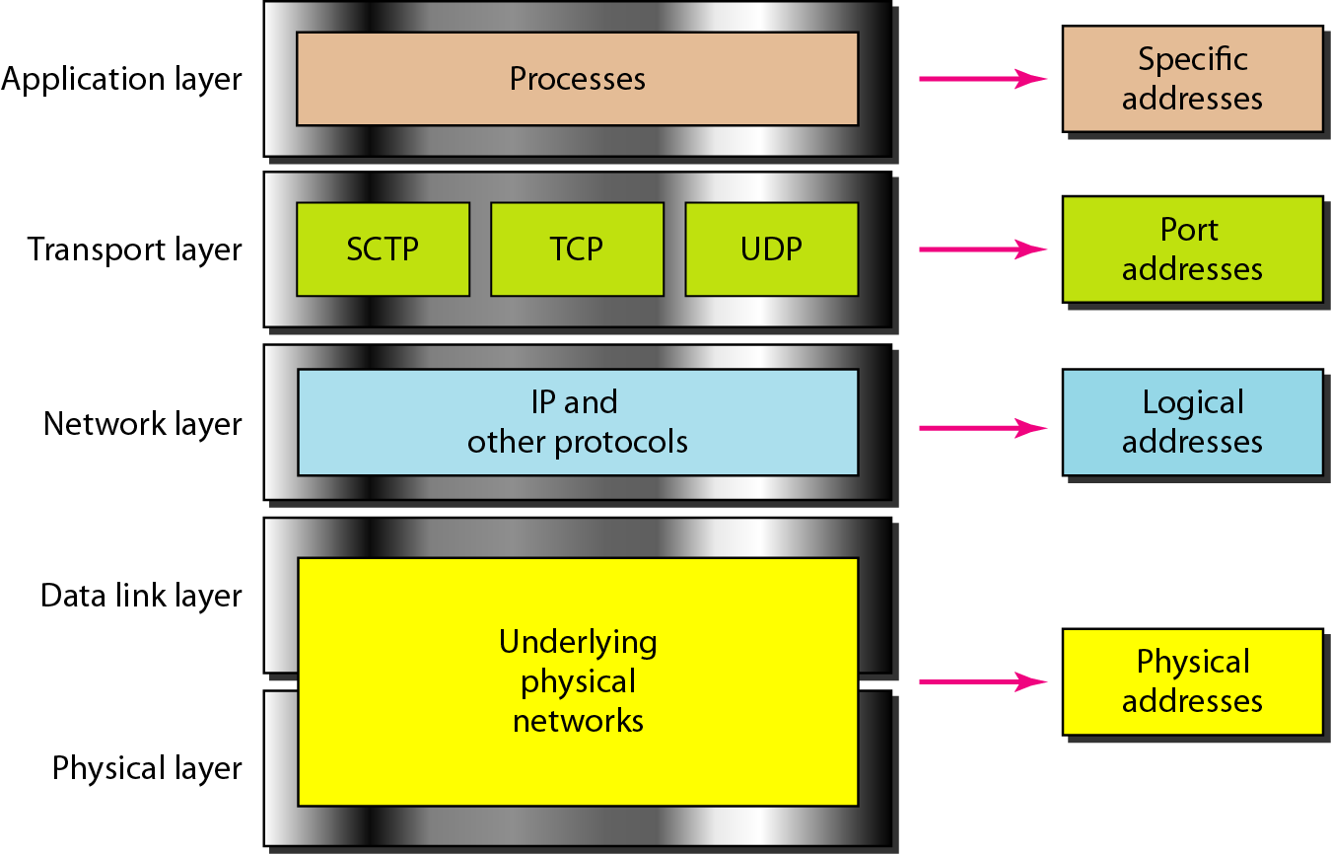

Slide 19
Network Topology
Topologies
Client- Server
LAN
MAN
WAN

Slide 20
Network Devices
Hub
Repeater
Bridge
Switch
Router
Gateway

Slide 21





Routing and Firewall
INTERNET
LAN

Slide 22


WAN
NAT
DMZ
FIREWALL
PORT FORWARDING
INTER
NET
WAN
LAN
Each device has different IP addresses

Slide 23
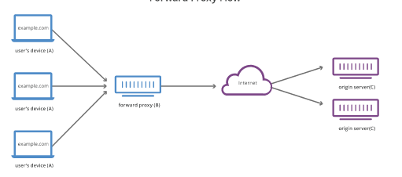
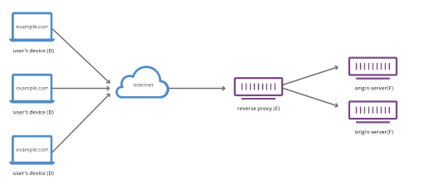
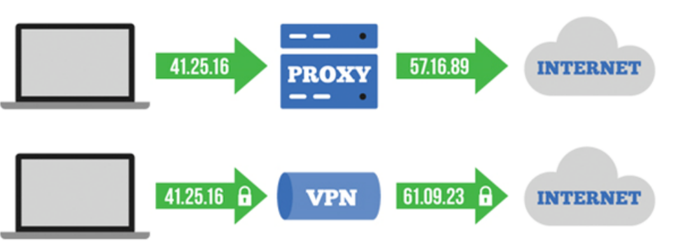
Proxy, Reverse Proxy, VPN

Slide 24
SELF-ASSESSMENT QUESTIONS
…
…
…
…
…
….
…
…
…
…

Slide 25
WWW
The World Wide WEB, Commonly known as the Web, is a system of interlinked hypertext/hypermedia documents accessed via the internet.
WWW: The means we use to access information over the internet
Different Communication protocols
Special link (hyperlink) that enable users to jump from one place to another on the web
Webpage: is a document or resource of information that is suitable for the WWW and can be accessed though a web browser and displayed on client machine
A web page has a unique address called Uniform Resource Locator ( URL )
Web Browser: S/W application for retrieving , presenting, and traversing information resources on the WWW

Slide 26
TERMINAL QUESTIONS
1. Describe
2. List out
3. Analyze
4. Summarize

Slide 27
REFERENCES FOR FURTHER LEARNING OF THE SESSION
Reference Books:
1.
2.
3.
Sites and Web links:
1.
2.
3.

Slide 28
THANK YOU
Team – Course Name

